Slide 1
AFFECTIONS OF Nasal cavity &Nostrils By :- abudulbari A.Alfaris

Slide 2
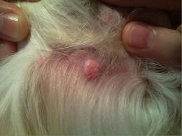
Atheroma
Atheroma is an epidermal inclusion cyst uncommon abnormality, frequently observed in the nasal passage of yearling.
This is a small fluctuant mass that occurs unilaterally (rarely bilaterally) at the caudal aspect of false nostril.
It is observed externally as a small swelling in this area.
It does not obstruct the airway but causes partial encroachment of the nasal passage resulting to nasal respiratory noise.

Slide 3
Treatment of Atheroma
The skin over the cyst is prepared aseptically by clipping, shaving and painting with povidone iodine for the operation and the tissues may be anaesthetized by infiltration with a local anaesthetic eg. 2% lignocaine hydrochloride.
A stab incision is made over the swelling area and evacuating the contents and swabbing its lining with tincture of iodine or any irritant or stimulating agent such as ammonia or turpentine liniment, constitute an effective method of treatment.
The irritant does not come in contact with the mucous membrane of the nose.
An alternative method of treatment is the dissecting out the cyst. It is the best method of treatment. The incision through the skin exposes the wall of the cyst. The wall should be separated from the surrounding tissues and excised.
It may be desirable to establish drainage into the nasal cavity. The edges of the skin incision may be united with simple interrupted suture with nylon or silk.

Slide 4
Treatment
Incise the cystic swelling,
Evacuate its contents and swabbing its lining with tincture of iodine or any irritating solutions.
Care should be taken that the irritant does not come in contact with the mucous membrane of the nose.
Complete removal of the cyst by surgical operation provides permanent cure of this condition.

Slide 5
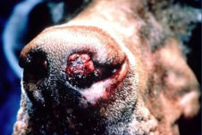
Nasal polyps
Polyp is fibrous and benign in nature, mainly composed of inflammatory cells.
Polys arise due to a chronic inflammatory process associated with chronic irritation due to certain infectious diseases.
Besides, focal accumulation of oedema fluid in nose mucosa with hyperplasia of the associated submucosal connective tissue is another causative factor.
The growths are commonly attached to the lateral wall and rarely to the nasal septum.

Slide 6
Signs
Mucoid or mucopurulent nasal discharge may come from nose.
Bleeding from nose (Epistaxis).
There may be frequent sneezing, restlessness and may rub its nostrils against the ground.
Occasionally more or less complete obstruction of bilateral nasal passage resulting to respiratory difficulty and exhibits mouth breathing.
Deformity of face due to bulging of the nasal bones and atrophy of the turbinate.

Slide 7
Diagnosis of Nasal polyps
Diagnosis of Nasal polyps in animals is done by-
Direct visualization
Endoscopic visualisation of the nasal cavity reveals the presence of growth
Radiography
Histopathology
Microbial culture examination

Slide 8
Treatment
Polyps can be excised by sharp dissection or by electro cautery. Haemorrhage is controlled by lugging the nasal cavity with adrenalin soaked gauze. The gauze may be changed after 24 hours.
But removed after 48 hours. Complete surgical removal is very unlikely, should be so chances of recurrence are common. Prognosis of such cases is guarded.
When the polyps extend up to the caudal aspect of the nasal septum, trephining of the nasal bones is indicated.
In case of bilateral and multiple benign tumours, surgical removal is impracticable. Tracheotomy should be performed in such cases to increase the usefulness of the animal.

Slide 9
Resection of the nasal septum
The nasal cavity is separated into two halves by the nasal septum which is mostly cartilaginous, but has bony and membranous portion
Diseases of the nasal septum are rare and are caused by abnormalities, traumatic injury or “cystic” degeneration and squamous cell carcinoma. Deformity of the nasal septum usually as part of the “wry nose” syndrome, can cause an airflow obstruction.

Slide 10
Treatment of Nasal polyps
Pedunculated growths are removed by excision at the base of the attachment by local infiltration anaesthesia.
When growths are enlarged and inaccessible through external nares, Rhinotomy and excision is indicated.
Rhinotomy
An incision through the skin and cartilage on the dorsolateral aspect of the nostril gives enough space to remove the growth from the nasal cavity. Base of the growth is debrided and cauterized.
Haemorrhage is controlled by temporary plugging of the nasal cavity with gauze impregnated with an antiseptic and intravenous administration of haemo-coagulase, vitamin K, ethamsylate.
Trephining of the nasal bones is indicated when polyps extends upto the caudal aspect of the nasal septum.

Slide 11
TREATMENT
The animal is placed in dorsal recumbency.
An incision is made in the skin and continued through the nasal cartilages, bone and turbinates.
The entire diseased portion of the septum is removed by using obstetrical wire.
Copious haemorrhage is to be controlled by packing the nasal passage with sterile gauge soaked in saline or in 1:100,000 epinephrine solution.
Finally, closure of the wound should be done in routine standard manner.
A tracheotomy is generally indicated for proper respiration.

Slide 12
POST OPERATIVE CARE
Parentral antibiotics and non-steroidal anti-inflammatory drugs.
The gauge packing and tracheotomy tube should be removed 48-72 hour after surgery.
Healing of the wound generally occurs by second intention within 3 week.

Slide 13
Necrosis of the turbinates
Occasionally encountered in horse and rarely in other animals.
There is accumulation of pus in the folds of the bones as a result of strangles.
It may also develop as result of wound caused by injury and localization of infection or complication of disease of the root of a molar tooth in its surroundings.
Signs
There is foetid purulent discharge from nose.
Interference in respiration manifested by a roaring noise.
Swelling in nasal chambers and submaxillary lymphatic glands.
Finally, there is ulceration and discolouration of the turbinate bone.

Slide 14
Treatment
Remove the necrotic bone by surgical operation.
The turbinate is to be severed above and below the affected part with a strong sharp scissors and remove it.
Antiseptic powder may be applied once daily into the affected region for healing of the wound area.

Slide 15
Treatment of Necrosis of the turbinate bone
Block the maxillary nerve and sedate the patient if necessary. It is also best to perform a tracheotomy.
Make a trephine opening where the nasal bones start to diverge and far enough from the median line to avoid injury to the nasal septum.
Cut the cartilaginous anterior end of the turbinate loose from its attachments anteriorly and with a nasal septum chisel cut the attachment.
Bleeding can be controlled by tamponing the cavity tightly with gauze. It is impossible to completely remove the ventral turbinate due to its anatomical location.
After operation, the affected region may be insufflated with iodoform powder or a mixture of it and boric acid once daily as a further antiseptic precaution.
Prognosis of Necrosis of the turbinate bone is favourable when the necrotic portion can be entirely removed.

Slide 16
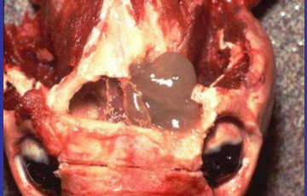
Parasites in the nasal chambers
Parasites mainly linguatula taenioides is of frequent occurrence in dog but is rarely observed in horse, sheep and goat.
The parasite may lodge in any part of the cavity but most commonly in the convolutions of the ethmoid and in the cul-de-sac of the middle meatus.
Larvae of the parasites usually remained in sheep and rabbit.
The dog may become infested by ingestion of the viscera of sheep and rabbit.
The parasite may remain for months in the nose, eventually die or expelled out.

Slide 17
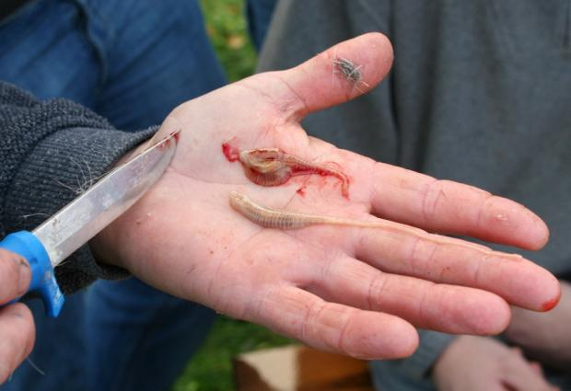
Signs
Presence of numerous parasites in nasal chambers may cause agitation of animals.
There is sneezing and scratching of nose with paws.
Mucoid blood tinged discharge may come out of the nose.
Treatment
Attempts may be made to remove the parasites from the nasal cavity either by forceful sneezing or by triphening.
Mild irritating solutions like ammonia or benzene may be introduced through the nostrils to dislodge or destroy the parasites.

Slide 18
Symptoms of Nasal parasites
The usual number of parasites is two that will cause no clinical signs but when they are more in number, they cause agitation of the host, the dog scratching his nose with his paws, sneezing frequently and sometimes showing aberrations simulating rabies.
There may be mucoid discharge from the nose, occasionally streaked with blood.
The parasites remain for months in the nose, eventually die or are expelled.
Diagnosis of Nasal parasites
Diagnosis of Nasal parasites is based on the following examination-
Direct finding the parasites and their eggs
Microscopic examination of nasal discharge
Differential diagnosis of Nasal parasites with nasal catarrh, distemper and rabies should be carried out.

Slide 19
Symptoms of Nasal parasites
The usual number of parasites is two that will cause no clinical signs but when they are more in number, they cause agitation of the host, the dog scratching his nose with his paws, sneezing frequently and sometimes showing aberrations simulating rabies.
There may be mucoid discharge from the nose, occasionally streaked with blood.
The parasites remain for months in the nose, eventually die or are expelled.
Diagnosis of Nasal parasites
Diagnosis of Nasal parasites is based on the following examination-
1. Direct finding the parasites and their eggs
2. Microscopic examination of nasal discharge
Differential diagnosis of Nasal parasites with nasal catarrh, distemper and rabies should be carried out.

Slide 20
Traumatic wound and fracture of the nasal bones
Traumatic wound in the nostrils and fracture of the nasal bones are common surgical affections of nose in automobile accidents.
Management of traumatic wound and fracture of the nasal bones
A tracheotomy operation is performed to permit breathing as it is necessary to tamponade the nasal cavity to control haemorrhage.
Anaesthesia is achieved by blocking both maxillary nerves, if necessary sedate the patient with appropriate drugs.
A trephine opening is made on the median line of the face at the point where the nasal bones start to diverge from each other.
This is determined by placing the thumb and finger on either side of the nasal bones and passing them backward over the dorso-lateral surface.
A pair of compression forceps with jaws four inches long is inserted through the trephine opening and astride the nasal septum.

Slide 21
The points of forceps should reach the full width of the nasal septum and are then closed tightly.
The nasal septum is then divided anteriorly by a curved incision, leaving at least two inches of the septum to support the nostril.
Secure the cut end with a pair of forceps, then place a nasal septum chisel astride the septum and push it along the superior border of the nasal septum until the chisel comes in contact with the forceps, withdraw the chisel and insert in the same manner along the floor of the nostril, cutting the septum free from the vomer bone with a narrow chisel placed anterior to and in contact with the forceps, divide the septum transversely and remove the septum through the nostril.
Tamponade the nasal cavity tightly with antiseptic impregnated gauze. It is advisable to suture the nostrils shut to retain the tampon in position.
The tampon and trachea tube may be removed in 48 hours. After operation, nasal cavity may be irrigated with a mild antiseptic solution through the trephine opening.

Slide 22
Foreign body in Nasal Cavity
Rostral turbinate system helps in the filtering of direct entry of small foreign bodies and very rarely they get lodged in the nasal mucosa to cause inflammation.
Clinical signs of Foreign body
Clinical signs of Foreign body in animals are-
Epistaxis
Excessive sneezing
Purulent discharge unilateral
Diagnosis of foreign body
Direct visualization with magnification
Otoscopy of the rostarl nasal passage.
Radiography- plain and with contrast radiography

Slide 23
Treatment of foreign body
Removal of the foreign body depends on the space and location. If Rostral side foreign body, use of a small alligator forceps along with endoscope. if Caudal side foreign body, it may be embedded in the mucosa or free in the passage, use of a flexible endoscope.
Nasopharynx 2-4 mm diameter arthroscope or in large dogs with a bronchoscope can be used.
Surgical approach for foreign body removal
There are two surgical approach for foreign body removal in animals-
Dorsal approach
Ventral approach

Slide 24
Dorsal approach
Make a dorsal midline skin incision from the caudal aspect of the nasal septum to the medial canthus of the orbit. Explore both the sides of the nasal cavity.
A bone saw can be used to elevate the periosteal flap on the proposed entry.
Gently lavage the nasal passage and remove the foreign body. Bone flaps are sutured by 3-0 or 4-0 wire sutures. close the skin with apposition sutures.
Ventral approach
Make a midline incision in the hard palate. Elevate the muco-periostium, without damaging the palatine vessels and nerves. Extend the incision caudally to the soft palate.
Incise the palatine bone with rongeurs or power driven burr. Explore the nasal cavity. After removing the foreign body Close the nasal mucosa and oral mucosa with simple interrupted sutures.

Slide 25
Thanks for attention

